Slide 1




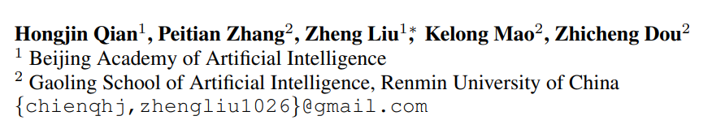





ATAI
Advanced Techniqueof Artificial Intelligence
ATAI
ChongqingUniversity _{AdvancedTechniqueof}
of Technology Artificial Intelligence
Chongqing University of
Technology
Chongqing University ^{ATAI}
_{of Technology} Advanced Techniqueof
Artificial Intelligence
Chongqing University of Technology
Chongqing University of Technology
MEMORAG: MOVING TOWARDS NEXT-GEN RAG VIA
MEMORY-INSPIRED KNOWLEDGE DISCOVERY
Code: https://github.com/qhjqhj00/MemoRAG/
2024.9. 29•ChongQing
—— arXiv 2024
Reported by Jinfei Chen
1

Slide 2

ATAI
AdvancedTechniqueof
Artificial Intelligence
ATAI
ChongqingUniversity _{AdvancedTechniqueof}
of Technology Artificial Intelligence
ChongqingUniversity of Technology
Motivation
The existing retrieval methods are constrained inherently, as they can only perform relevance matching between explicitly stated queries and well-formed knowledge, but unable to handle tasks involving ambiguous information needs or unstructured knowledge. Consequently, existing RAG systems are primarily effective for straightforward question-answering tasks.

Slide 3

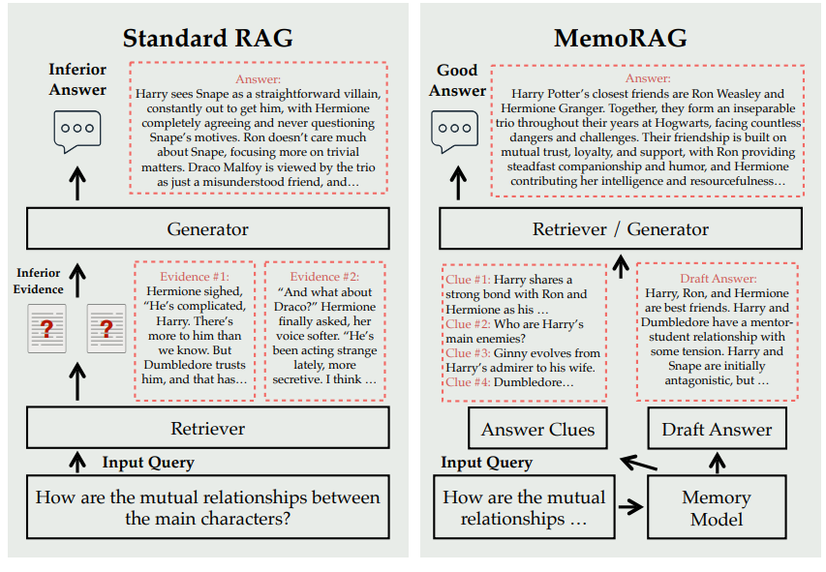
ChongqingUniversity of Technology
ATAI
AdvancedTechniqueof
Artificial Intelligence
ATAI
ChongqingUniversity _{AdvancedTechniqueof}
of Technology Artificial Intelligence
Overview

Slide 4

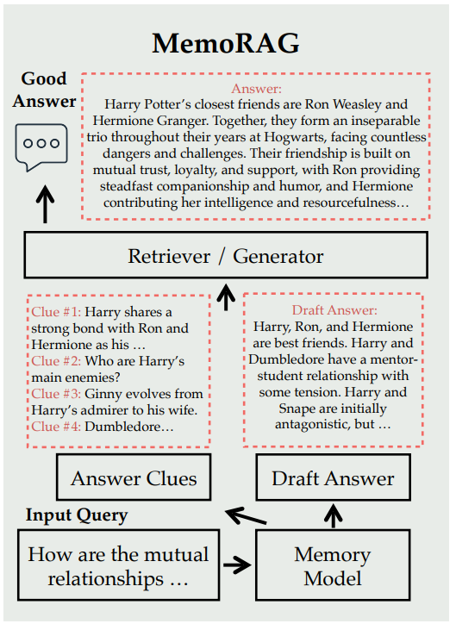
ChongqingUniversity of Technology
ATAI
AdvancedTechniqueof
Artificial Intelligence
ATAI
ChongqingUniversity _{AdvancedTechniqueof}
of Technology Artificial Intelligence
Method

Slide 5

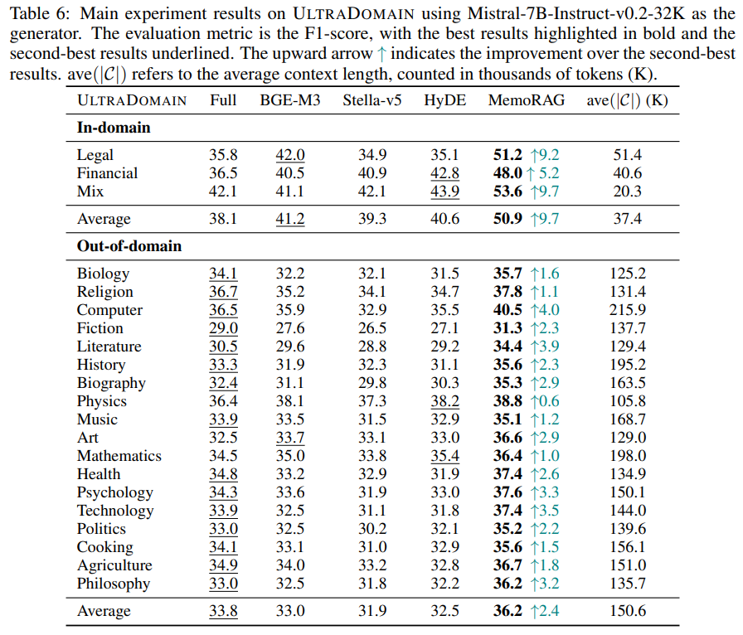
ATAI
AdvancedTechniqueof
Artificial Intelligence
ATAI
ChongqingUniversity _{AdvancedTechniqueof}
of Technology Artificial Intelligence
ChongqingUniversity of Technology
Experiments

Slide 6
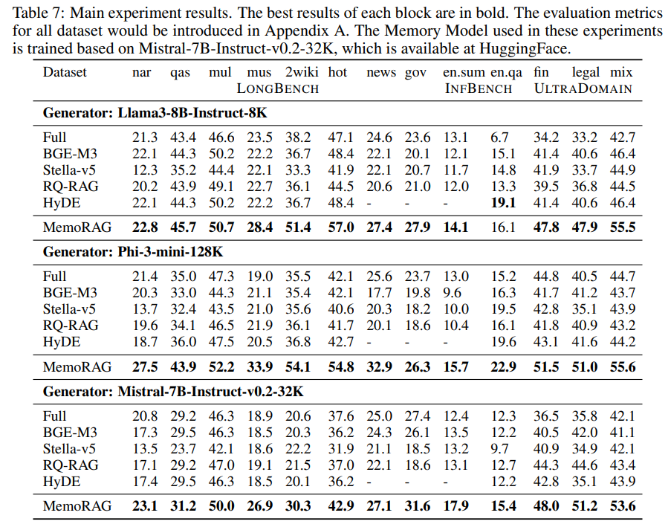
ATAI
AdvancedTechniqueof
Artificial Intelligence
ATAI
ChongqingUniversity _{AdvancedTechniqueof}
of Technology Artificial Intelligence
ChongqingUniversity of Technology
Experiments

Slide 7


ChongqingUniversity of Technology
ATAI
AdvancedTechniqueof
Artificial Intelligence
ATAI
ChongqingUniversity _{AdvancedTechniqueof}
of Technology Artificial Intelligence
Thanks!

